Slide 1

PingPong Survey Results
Presented by Hannah Brown
Notes:
Hello everyone, my name is Hannah. Thank you all for being here today. Today will be a short presentation on the use of the AI software PingPong in the class STAT131A at Berkeley.

Slide 2

Who am I?
Data science student writing honors thesis on LLMs in education
Developing a customized LLM chatbot with Narges Norouzi
Launching in data 100 + cs61a this semester
Notes:
Mention that the chatbot is called Edison and is similar to PingPong but trained in house on Ed data

Slide 3
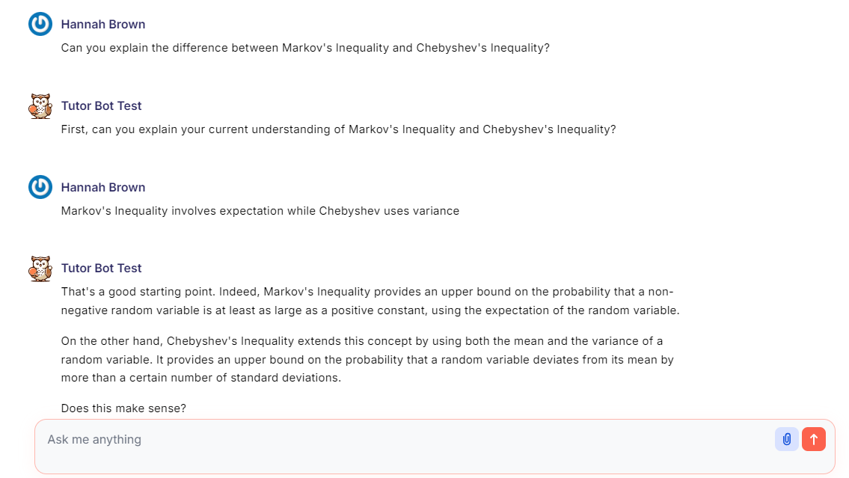
What is PingPong?
AI-powered, customizable teaching assistant based on ChatGPT
Developed at Harvard
Used in Fall 2024 Stat 131A
Notes:
The name PingPong represents a back and forth between student and AI. Unlike other LLMs where it is usually Q&A, PingPong acts more as a tutor going back and forth with the students like a game of Ping Pong.

Slide 4
Live Demo
Notes:
https://pingpong.hks.harvard.edu/group/62?assistant=569
I have a dataset with columns: carmodel, year, fuel efficiency (mpg), weight, horsepower I need to summarize efficiency with scatter plot by plotting fuel efficiency and weight. Also show in chatgpt side by side

Slide 5
What is PingPong’s significance?
LLMs are easily accessible + freely provide answers
PingPong makes it easy for students to use LLMs appropriately
Notes:
In other words, if we tell students that no LLMs are allowed, they will likely still use it while feeling guilty. However, if we make it easy for the student to have access to a better resource that the professor moderates, both the student and professor benefit. The student will learn more, and the professor will have an extra form of support for their class.

Slide 6

Why Research PingPong Usage?
Demonstrate how LLMs can be used to benefit education
Increase number of educational resources
Make tutoring widely available
Lower the barrier of entry to get help
SLC at Berkeley
Notes:
Right now, many are focused on the negative aspects of LLMs in education. There are many benefits as mentioned before. Although this survey aims to show the benefit of a restricted LLM in classroom, it will also highlight some of the concerns of the student’s themselves.

Slide 7
Why Research PingPong Usage?
Demonstrate how LLMs can be used to benefit education
Increase number of educational resources
Make tutoring widely available
Lower the barrier of entry to get help
Note the consequences of LLMs usage
Lower office hours attendance
Dependence on AI
Unreliable information
SLC at Berkeley
Notes:
Right now, many are focused on the negative aspects of LLMs in education. There are many benefits as mentioned before. Although this survey aims to show the benefit of a restricted LLM in classroom, it will also highlight some of the concerns of the student’s themselves.

Slide 8
About our Online Survey
Target Population: Stat 131A students (mostly DS minors)
Anonymous
~15 questions
53 non-incentivized responses from a class of 88 (~60%)
Notes:
For my thesis, I wanted to survey a class that already had experience using a LLM chatbot,which STAT 131A was a perfect candidate for

Slide 9
Four Big Ideas From Survey
1. Students are aware+concerned about LLM dependence
2. PingPong slows down interactions (liked+disliked)
3. Students want customized chatbots in other courses
4. Students believe they go to OH less because of LLMs
Notes:
Before we get into the survey results here are…

Slide 10
Now let’s get into the survey results...

Slide 11
2/3 of respondents chatted w/ PingPong >10x
Question: How many times have you used PingPong, approximately?
Notes:
We see that this resource is utilized with 83% of respondents having more than 5 chats

Slide 12
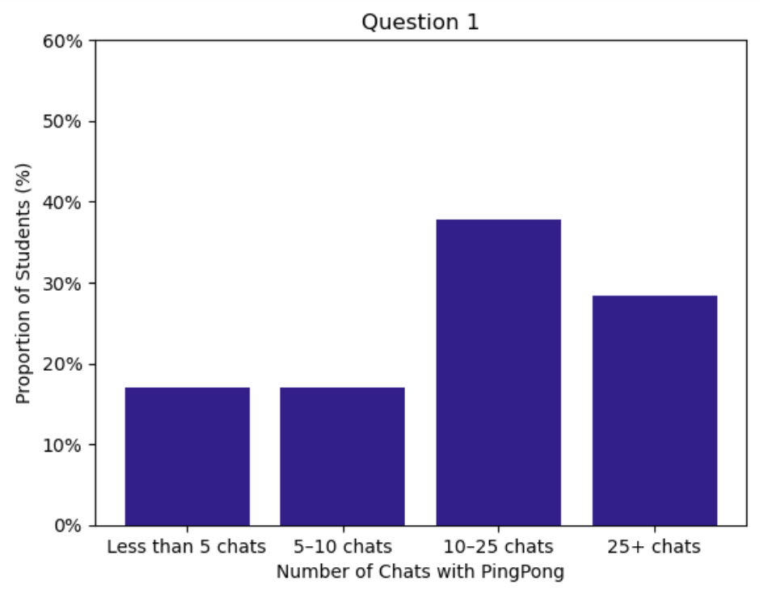
2/3 of respondents chatted w/ PingPong >10x
Question: How many times have you used PingPong, approximately?
Notes:
We see that this resource is utilized with 83% of respondents having more than 5 chats

Slide 13
Those who chatted w/ PingPong more than 5 times:
Notes:
Now we will go over survey questions only active users of PingPong answered

Slide 14
Minority of students prefer vanilla ChatGPT
Question: If you wanted to learn more about a statistical concept, would you prefer to use PingPong or another LLM?
Question: Please elaborate on your response to the previous question.

Slide 15
Few students prefer vanilla ChatGPT
Question: If you wanted to learn more about a statistical concept, would you prefer to use PingPong or another LLM?
Question: Please elaborate on your response to the previous question.
45% - I would prefer to use PingPong
25% - I would prefer to use another LLM
30% - I am indifferent

Slide 16
Few students prefer vanilla ChatGPT
Question: If you wanted to learn more about a statistical concept, would you prefer to use PingPong or another LLM?
Question: Please elaborate on your response to the previous question.
45% - I would prefer to use PingPong
“I feel PingPong will actually challenge me to further understand the concept while another LLM such as ChatGPT would just give me the answer. ”
25% - I would prefer to use another LLM
30% - I am indifferent
“Pingpong seems very specialized toward the course I am taking, and I feel the responses show better understanding and relevance to course concepts compared to other LLMs.”
Notes:
Most student prefer PingPong over other LLMs. With common reasoning being that, despite their annoyance, PingPong forces them to explain understanding and that the professor approved and provided this resource.

Slide 17
Few students prefer vanilla ChatGPT
Question: If you wanted to learn more about a statistical concept, would you prefer to use PingPong or another LLM?
Question: Please elaborate on your response to the previous question.
45% - I would prefer to use PingPong
“Other LLMs feel more efficient. They give the answer clearly and concisely better than PingPong.”
25% - I would prefer to use another LLM
“Other LLMs seem to have more context when I ask questions for studying purposes... E.g. if I ask it to explain a function, it asks me to first try to explain it, but in that context it makes more sense for PingPong to just explain the function.”
30% - I am indifferent
Notes:
Students that prefer other LLMs, note that they are simply more efficient and concise. In addition, sometimes student just need context and want that summarized information, which PingPong is not the best for.

Slide 18
Few prefer vanilla ChatGPT
Question: If you wanted to learn more about a statistical concept, would you prefer to use PingPong or another LLM?
Question: Please elaborate on your response to the previous question.
45% - I would prefer to use PingPong
“Depending on the type of question or prompt I am asking, I think I would prefer to use the LLM of Ping Pong over Chat GPT more for learning information on a specific topic as that is what I used it on… But I would use chat gpt for ideas in terms of paper formatting, code output, and general use as I enjoy the simplicity and aesthetic of chatgpt.”
25% - I would prefer to use another LLM
30% - I am indifferent
Notes:
The indifferent crowd echos the preferences of both groups: PingPong and ChatGPT are inherently designed for different things. PingPong is better for learning new information while ChatGPT is better at summarizing information and formatting. This student also highlights that simply, ChatGPT is more developed and has better UI.

Slide 19
Moving to questions posed to all students:
Notes:
Now we will move on to questions that ALL students, regardless of PingPong usage answered.

Slide 20
Are LLMs replacing course staff?
Question 6: If course staff were not available, what percentage of your questions could PingPong fully answer?
Question 9: Without access to LLMs, I would attend STAT 131A office hours...

Slide 21
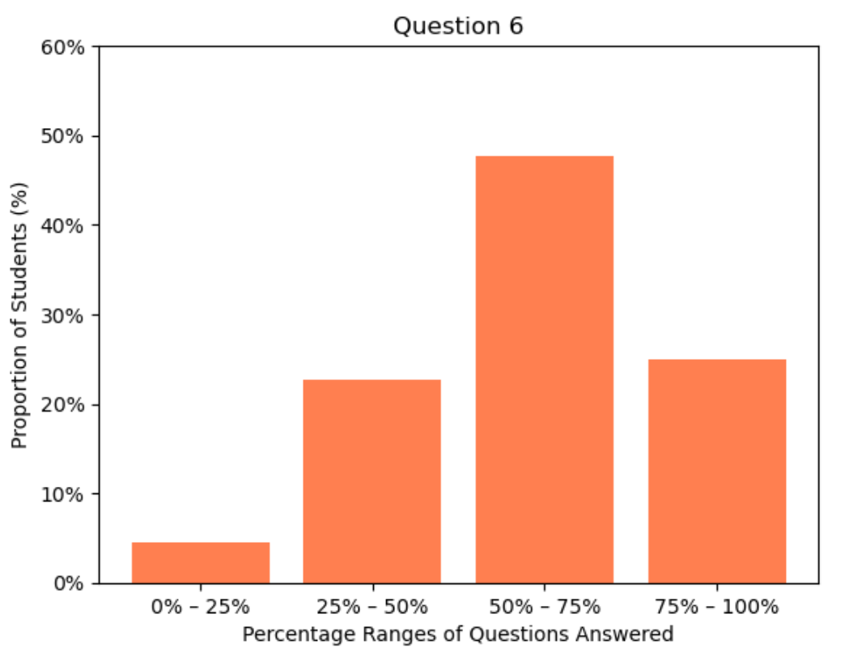
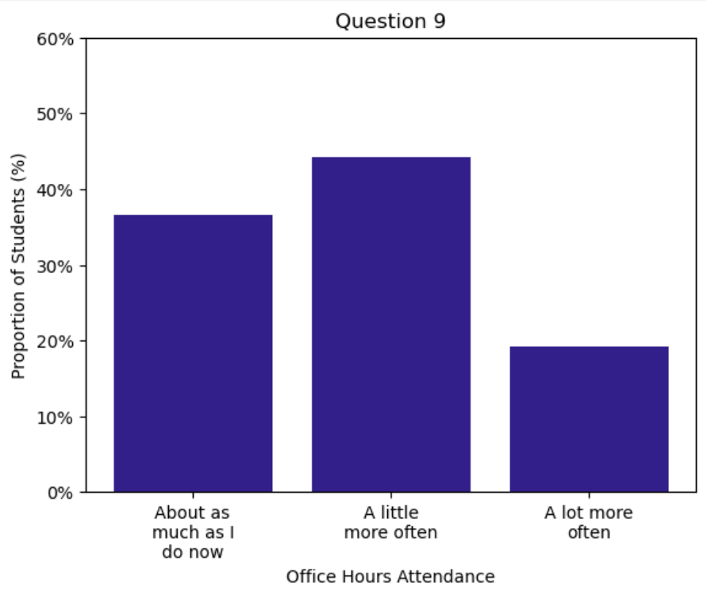
Majority of questions are answered by PingPong
Question 6: If course staff were not available, what percentage of your questions could PingPong fully answer?
Question 9: Without access to LLMs, I would attend STAT 131A office hours...
Notes:
Here we can definitely see the arguably negative consequences of LLM tutors: less usage of tutors which may contribute to making tutors obsolete with most students admitting that most of their questions are answered and they do not go to office hours as much anymore.
However, in much larger classes at Berkeley, office hours waiting times can be upwards of an hour, so they may help with the current resources given by focusing office hours energy on more complex questions. If the school continues to limit budget for tutoring, then LLMs tutors is the best way to make education more accessible.
In addition, this could call for a reorganization of office hours. Instead of office hours maybe schedule homework parties or group tutoring, but I will touch on this again later.
–
Quick comment about Question 9 is the reason we did not ask if the student would go to office hours less is: one to not confuse students with more options, and two it does not make sense in the context as LLMs provide an extra resource for students to use meaning the baseline is how often the student goes to OH without LLMs.

Slide 22
Half think their understanding is different
Question: Without LLMs, do you think your understanding of the STAT 131A material would be different?

Slide 23
Half think their understanding is different
Question: Without LLMs, do you think your understanding of the STAT 131A material would be different?
No: 49%
Yes: 51%
Notes:
This question was the most polarizing in the class with almost a 50/50 split.

Slide 24
Half think their understanding is different
Question: Without LLMs, do you think your understanding of the STAT 131A material would be different?
No: 49%
Yes: 51%
“Probably not. I mostly use lecture slides, and sometimes go to PingPong to refresh my memory, not necessarily to understand concepts differently.”
“No, because the other resources adequately cover the material.”
“I think it would be about the same, assignments would just take longer due to minor misunderstandings.”
Notes:
Those who argue No say that it is due to PingPong just helps them save time by summarizing content and clearing minor misunderstandings. They overall think that the class is able to teach the material on its own it may just take longer to get to the same understanding without PingPong.

Slide 25
Half think their understanding is different
Question: Without LLMs, do you think your understanding of the STAT 131A material would be different?
No: 49%
Yes: 51%
“Probably not. I mostly use lecture slides, and sometimes go to PingPong to refresh my memory, not necessarily to understand concepts differently.”
“Yes, it would be worse because LLMs answer my questions in real time and I don't feel 'judged' by my lack of understanding of a topic.”
“No, because the other resources adequately cover the material.”
“Yes I think I’d understand a bit less given that sometimes office hours conflicts with other things I can rely on Pingpong to explain concepts I’m confused about from lecture.”
“I think it would be about the same, assignments would just take longer due to minor misunderstandings.”
Notes:
Those who say Yes, it would change their understanding, overall claiming that PingPong is a 24/7 office hours where they can address their questions instantaneously. One even highlights that they do not feel judged by their lack of understanding, so they do not feel afraid to ask basic questions.

Slide 26
Do LLMs change grades?
Question: Without LLMs, do think your homework and exam grades in STAT 131A would be different?
Notes:
We just went over if understanding of class material would change, now what about overall grade?

Slide 27
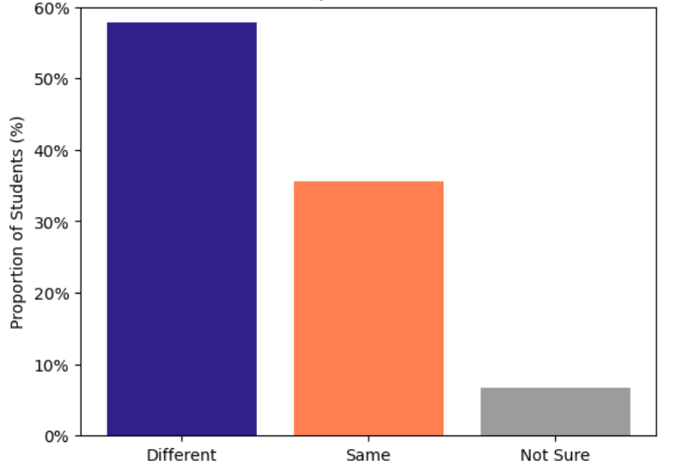
58% of grades might be affected
Question: Without LLMs, do think your homework and exam grades in STAT 131A would be different?
Same: 35%
Different: 58%
Notes:
Unlike the last question we now see a majority that their grade would change. This is interesting because although understanding of material might have not changed, their grade most likely would be different.

Slide 28
58% of grades might be affected
Question: Without LLMs, do think your homework and exam grades in STAT 131A would be different?
Same: 35%
Different: 58%
“I tend to use PingPong and office hours in tandem; if I can't receive enough help for homework then I would go to office hours instead.”
“Probably not, BUT it really helps me cut down on the time I spend on homework because I can get quick feedback on why my code is wrong without spending hours debugging.”
Notes:
First let’s go to the minority, the group that says their grade would not change. Similar to sentiments before, if PingPong did not exist they would either fill in the gaps with OH or just spend more time reviewing or debugging.saving time on debugging) BUT this group thinks this time saved substantially helps improve their grade.

Slide 29
58% of grades might be affected
Question: Without LLMs, do think your homework and exam grades in STAT 131A would be different?
Same: 35%
Different: 58%
“I tend to use PingPong and office hours in tandem; if I can't receive enough help for homework then I would go to office hours instead.”
“Yes... when working through understanding a concept, I want anything I am confused about answered... I study/work mostly at night/late at night, it makes having an LLM basically accessible for small questions and clarity.”
“Probably not, BUT it really helps me cut down on the time I spend on homework because I can get quick feedback on why my code is wrong without spending hours debugging.”
“I think I would do worse on the homework without the assistance of the LLMs. PingPong has helped me save time and improve my grades.”
Notes:
Now to the majority, who believe their grade would change. Basically the converse of the No group, PingPong acts as a 24/7 office hours which is essential to their learning as time saved actually has an effect of their grade. Both groups agree that time is saved with PingPong (through not going to office hours as much and saving time on debugging) BUT this group thinks this time saved substantially helps improve their grade.

Slide 30
Do students prefer customized chatbots?
Question: Which of the following would you prefer?
1. Programming+statistics courses allow students to use any LLM for homework help.
2. Programming+statistics courses only allow customized chatbots, similar to PingPong.
3. Programming+statistics courses do not allow students to use any LLM.
Notes:
Let’s see how these students who most have experience with PingPong, or another LLM, feel about customized chatbots after a whole semester of using one.

Slide 31
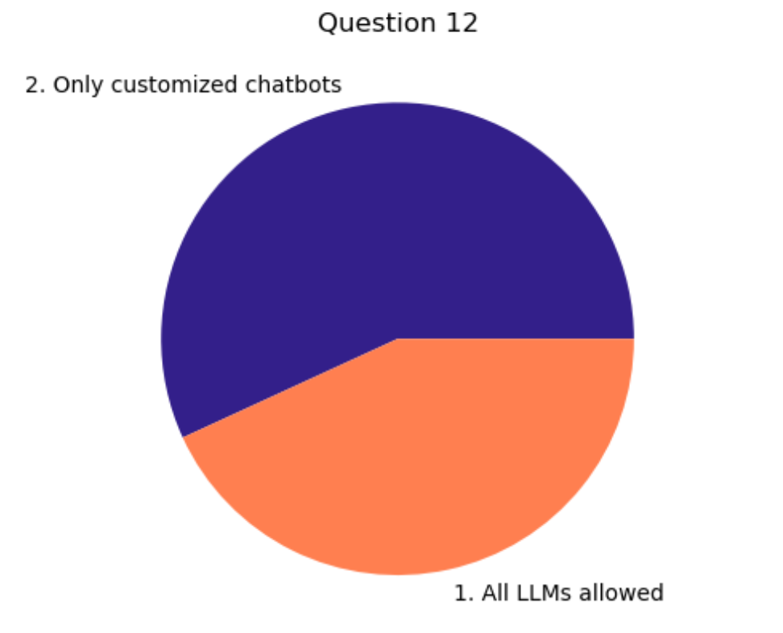
Not a single student wants to ban LLMs!
Question: Which of the following would you prefer?
1. Programming+statistics courses allow students to use any LLM for homework help.
2. Programming+statistics courses only allow customized chatbots, similar to PingPong.
3. Programming+statistics courses do not allow students to use any LLM.
Notes:
Notice how no one choose “No LLMs at all” despite a handful of people in this class being very adamantly against AI. Let’s see why this is.

Slide 32
Not a single student wants to ban LLMs!
Question: Please elaborate on your response to the previous question. Why do you prefer your chosen option?
Those who prefer allowing only customized chatbots: 57%
Notes:
Lets see what the majority of students say first.

Slide 33
Not a single student wants to ban LLMs!
Question: Please elaborate on your response to the previous question. Why do you prefer your chosen option?
Those who prefer allowing only customized chatbots: 57%
“When I can't make it to campus for office hours, a customized LLM can help take the place of office hours and offer help with specific homework questions.”
“Any LLM is just harmful for student's learning, but I feel like I am able to leave PingPong actually understanding concepts and material.”
“I like when I know the instructor can customize and suggest an LLM that I can trust.”
“I like having the freedom with restrictions. I know myself and I know that if I use something like ChatGPT I will not actually learn the material.”
Notes:
This student thinks customized chatbots can help when office hours are inaccessible or unavailable to the student.

Slide 34
Not a single student wants to ban LLMs!
Question: Please elaborate on your response to the previous question. Why do you prefer your chosen option?
Those who prefer allowing only customized chatbots: 57%
“When I can't make it to campus for office hours, a customized LLM can help take the place of office hours and offer help with specific homework questions.”
“Any LLM is just harmful for student's learning, but I feel like I am able to leave PingPong actually understanding concepts and material.”
“I like when I know the instructor can customize and suggest an LLM that I can trust.”
“I like having the freedom with restrictions. I know myself and I know that if I use something like ChatGPT I will not actually learn the material.”
Notes:
This student thinks all LLMs are harmful but PingPong is the lesser of the evils.

Slide 35
Not a single student wants to ban LLMs!
Question: Please elaborate on your response to the previous question. Why do you prefer your chosen option?
Those who prefer allowing only customized chatbots: 57%
“When I can't make it to campus for office hours, a customized LLM can help take the place of office hours and offer help with specific homework questions.”
“Any LLM is just harmful for student's learning, but I feel like I am able to leave PingPong actually understanding concepts and material.”
“I like when I know the instructor can customize and suggest an LLM that I can trust.”
“I like having the freedom with restrictions. I know myself and I know that if I use something like ChatGPT I will not actually learn the material.”
Notes:
This student reflects a popular opinion in the class which is that customized chatbots are custom to that course and approved by the Professor. Instead of them using ChatGPT which is not trained for that course, as well as, looked down on by the professor, the students feel much better and get a lot more out of a software like PingPong.

Slide 36
Not a single student wants to ban LLMs!
Question: Please elaborate on your response to the previous question. Why do you prefer your chosen option?
Those who prefer allowing only customized chatbots: 57%
“When I can't make it to campus for office hours, a customized LLM can help take the place of office hours and offer help with specific homework questions.”
“Any LLM is just harmful for student's learning, but I feel like I am able to leave PingPong actually understanding concepts and material.”
“I like when I know the instructor can customize and suggest an LLM that I can trust.”
“I like having the freedom with restrictions. I know myself and I know that if I use something like ChatGPT I will not actually learn the material.”
Notes:
This student mentions how they like the restrictions of PingPong and how it makes them slow down and absorb the material.

Slide 37
Not a single student wants to ban LLMs!
Question: Please elaborate on your response to the previous question. Why do you prefer your chosen option?
Those who prefer all LLMs: 43%
Notes:
Now let’s see the slight minority, those who think all LLMs should be permitted.

Slide 38
Not a single student wants to ban LLMs!
Question: Please elaborate on your response to the previous question. Why do you prefer your chosen option?
Those who prefer all LLMs: 43%
“I think people revert to GPT regardless”
“I think students can use any resource out there as long as it adheres to academic honesty.”
“The world is pushing towards LLM use in every avenue of life and to restrict it in a classroom setting is doing a disservice to students trying to prepare for the real world.”
Notes:
This student thinks that no matter the restrictions, people will do what they want.

Slide 39
Not a single student wants to ban LLMs!
Question: Please elaborate on your response to the previous question. Why do you prefer your chosen option?
Those who prefer all LLMs: 43%
“I think people revert to GPT regardless”
“I think students can use any resource out there as long as it adheres to academic honesty.”
“The world is pushing towards LLM use in every avenue of life and to restrict it in a classroom setting is doing a disservice to students trying to prepare for the real world.”
Notes:
This student thinks that no matter the restrictions, people will do what they want.

Slide 40
Not a single student wants to ban LLMs!
Question: Please elaborate on your response to the previous question. Why do you prefer your chosen option?
Those who prefer all LLMs: 43%
“I think people revert to GPT regardless”
“I think students can use any resource out there as long as it adheres to academic honesty.”
“The world is pushing towards LLM use in every avenue of life and to restrict it in a classroom setting is doing a disservice to students trying to prepare for the real world.”
Notes:
This student thinks that no matter the restrictions, people will do what they want.

Slide 41
Students are concerned about LLM dependence
Question: What concerns, if any, do you have about AI in education? Has PingPong changed your perspective at all?
Notes:
We finally asked all students a general question about how they feel about our future now that AI is so prominent in our lives. I think these quotes speak for themselves so I will just read them aloud.

Slide 42
Students are concerned about LLM dependence
Question: What concerns, if any, do you have about AI in education? Has PingPong changed your perspective at all?
“I have a concern that students will use LLMs and AI as a crutch and will not be able to hold their own. Sites like PingPong do ease that fear, however, because it is built in a way that requires I have an understanding while other LLMs may just spit out answers.”

Slide 43
Students are concerned about LLM dependence
Question: What concerns, if any, do you have about AI in education? Has PingPong changed your perspective at all?
“I have a concern that students will use LLMs and AI as a crutch and will not be able to hold their own. Sites like PingPong do ease that fear, however, because it is built in a way that requires I have an understanding while other LLMs may just spit out answers.”
“While I like how AI has helped in making tasks more efficient, I prefer the time when people put in the work and had to put thought into their work. I fear AI is making us lose our creativity and original thoughts.”

Slide 44
Students are concerned about LLM dependence
Question: What concerns, if any, do you have about AI in education? Has PingPong changed your perspective at all?
“Rather than concern whether AI will replace tutors, perhaps we need more course staff in general if there’s a gap in getting our questions met?”

Slide 45
Students are concerned about LLM dependence
Question: What concerns, if any, do you have about AI in education? Has PingPong changed your perspective at all?
“Rather than concern whether AI will replace tutors, perhaps we need more course staff in general if there’s a gap in getting our questions met?”
“I hope instead of banning the use of LLMs in classrooms, we should be taught to integrate it into our work. I like how we were taught to use Ping Pong as a tool in this course.”

Slide 46
Students are concerned about LLM dependence
Question: What concerns, if any, do you have about AI in education? Has PingPong changed your perspective at all?
“Rather than concern whether AI will replace tutors, perhaps we need more course staff in general if there’s a gap in getting our questions met?”
“I hope instead of banning the use of LLMs in classrooms, we should be taught to integrate it into our work. I like how we were taught to use Ping Pong as a tool in this course.”
“I feel positively and more optimistic that an amazing resource exists.”
Notes:
As a whole, student share a lot of the concerns that educators have. Despite being worried about AI dependence, maybe this highlights a larger issue concerning course staff and actually being taught how to use LLMs.

Slide 47
For those who chatted with PingPong less than 5 times:
Notes:
The last group we will briefly cover are those who chose not utilize PingPong.

Slide 48
16% had less than 5 chats
Question: Why have you chatted with PingPong less than 5 times?
Question: Would you use PingPong more if it were different?

Slide 49
16% had less than 5 chats
Question: Why have you chatted with PingPong less than 5 times?
Question: Would you use PingPong more if it were different?
3 students - I have not needed help from an LLM in Stat 131A, BUT I use LLMs for help in other classes
3 students - I prefer NOT to use LLMs for help with ANY of my coursework
1 student - I’m not sure how to integrate LLMs into my study routine
1 student - I prefer to use other LLMs for STAT 131A material
Notes:
Here are the options for why they did not use PingPong
Most students do not need LLMs in this class or prefer not to use them altogether. Only 1 uses other LLMs instead (which is not allowed in this course which may have biased the responses)

Slide 50
16% had less than 5 chats
Question: Why have you chatted with PingPong less than 5 times?
Question: Would you use PingPong more if it were different?
3 students - I have not needed help from an LLM in Stat 131A, BUT I use LLMs for help in other classes
3 students - I prefer NOT to use LLMs for help with ANY of my coursework
1 student - I’m not sure how to integrate LLMs into my study routine
1 student - I prefer to use other LLMs for STAT 131A material
“Perhaps. I find that it tends to make me more confused or take me on a circuitous route.”
“No, I think Ping Pong works just fine. I just personally prefer to stay away from using LLMs in my learning.”
“I think I just never took the time to see how PingPong worked and what was different about it.”
Notes:
The reason why one student does not use PingPong has been brought up before- PingPong has trouble getting to the point or giving context. Even students who have used PingPong extensively agree that this is an issue with PingPong, which is partially how it was trained, but also depends on how the instructor prompts the bot.

Slide 51
Reflection

Slide 52
Four Big Ideas From Survey
Students are aware+concerned about LLM dependence
Concerns about the future
PingPong slows down interactions (liked+disliked)
Less efficient, but helps them think
Students want customized chatbots in other courses
Like the customization/ Professor Approval
Students believe they go to OH less because of LLMs
Want more staff? More understanding staff?
Notes:
Let’s go back to the Big Ideas from earlier

Slide 53
Future?
Courses have custom chatbots, like Stat 131A, as a resource
Instructors should demonstrate how to productively use LLMs
Structure of office hours will have to adapt
Re-allocate TA’s time
Group Tutoring / Homework Party
Notes:
It is unrealistic to assume the students will not use widely available LLMs, so there is a need to provide custom chatbots as a resource. When educators provide this as a resource, they need to also show how to properly use this technology. Lastly, since we see that students are using office hours less because of this resource, I think that structure or idea of office hours needs to adapt. For example, instead of having it being a Q&A format, maybe have office hours be open-ended discussion, group tutoring, or just a time to work on assignments together like a homework party. This takes away the imitation of needing a “non-dumb” question, and motivates the student to show up to office hours.

Slide 54
Questions? Opinions? Comments?
What are your thoughts as educators?
What are you all doing to adapt your curriculum?

